Slide 1
rdborrow: An R package for Causal Inference Incorporating External Controls in Randomized Controlled Trials with Longitudinal Outcomes
Lei Shi 2023-2024 Genentech Intern
Joint work with Herb Pang, Chen Chen and Jiawen Zhu

Slide 2
Content
Background: augmenting RCTs with external controls
Methodology: causal inference with external controls
rdborrow
Architecture of the package
Numerical results with a simulated data
Live Demo of the package
Discussion
Acknowledgement
Notes:
Label the slides number
Live demo will pass to chen / OLE we do not run

Slide 3
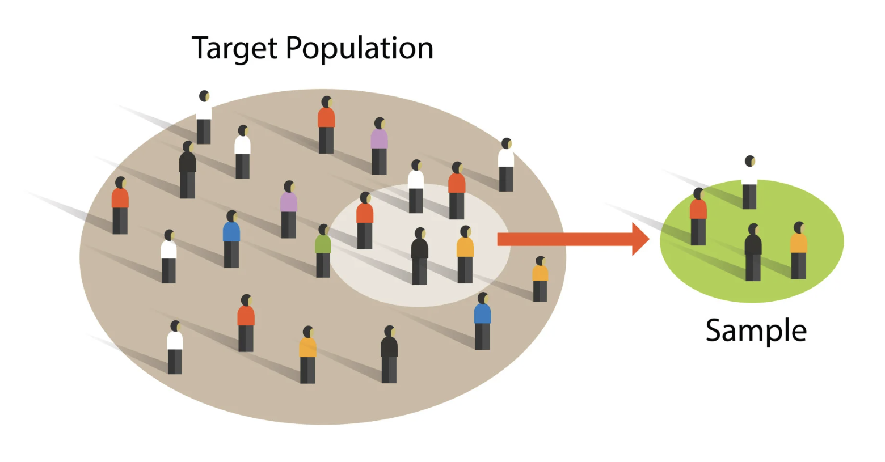
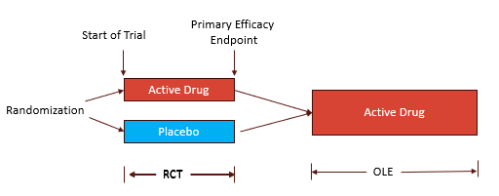
Background: RCT with external controls
Randomized controlled trials (RCTs) are considered the gold standard for treatment effect evaluation in clinical development.
However, designing and analyzing RCTs poses many challenges…
ensure validity and improve power for hypothesis testing with a limited sample size
account for a crossover in treatment allocation for long-term evaluation

Slide 4
Background: RCT with external controls
One promising approach to circumvent these problems is to incorporate external controls from additional data sources.
“External controls” (EC) refers to a comparison group of people external to the trial of interest who had not received the experimental treatment
RCT with EC is gaining traction in regulatory agencies (FDA 2023) and industry (Burger et al. 2021).

Slide 5
Background: Motivating trials
Main study: A Phase-3 study in SMA patients conducted by Roche
A placebo-controlled phase (with control arm)
An open-label extension phase (without control arm)
External study: a Phase 2 Study for the same disease population
shares the same set of measurements and follow-up visits as the main study
has a control arm that spans over the full study period
Notes:
Remove the firefish

Slide 6
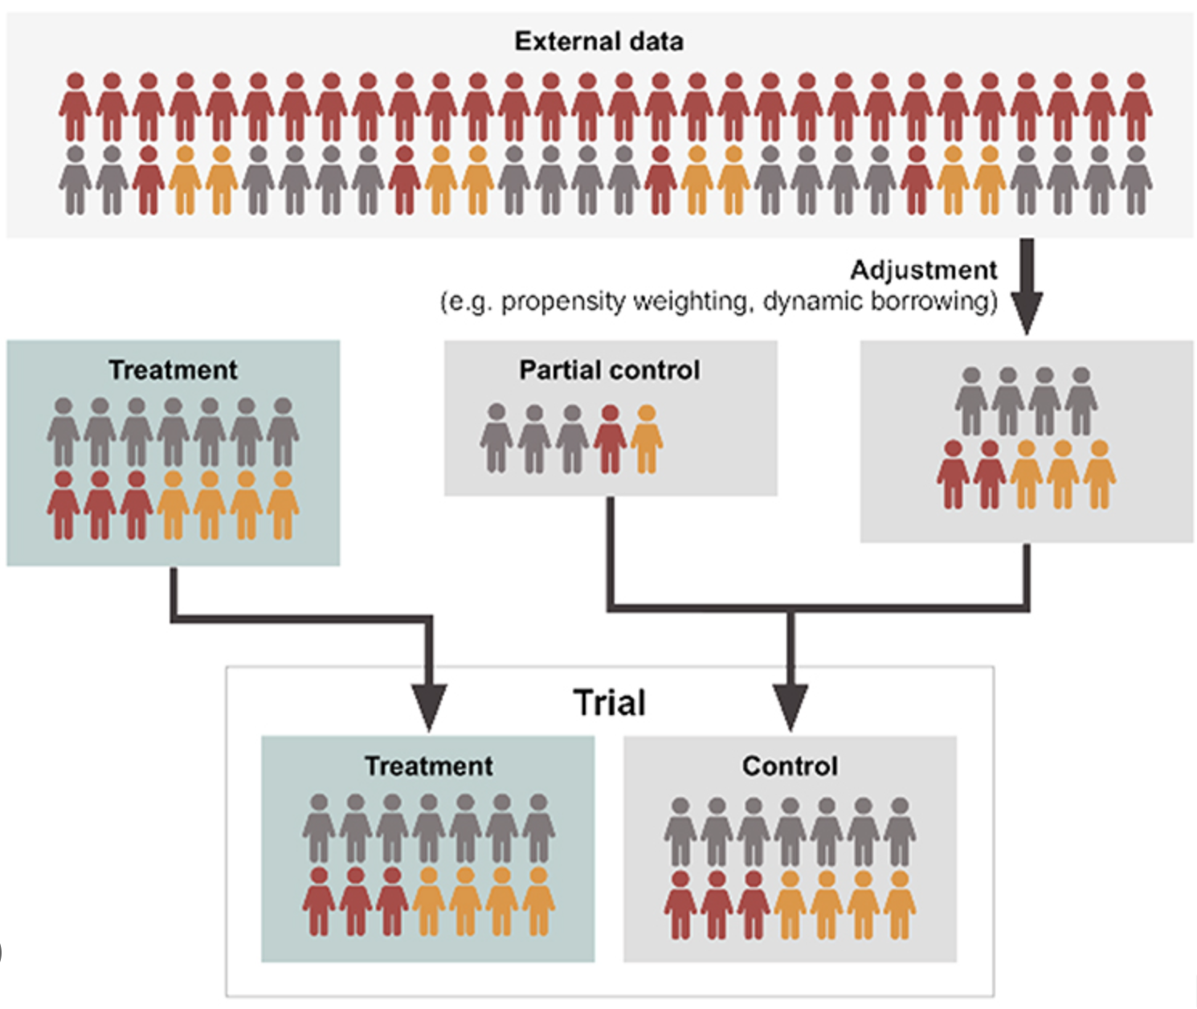
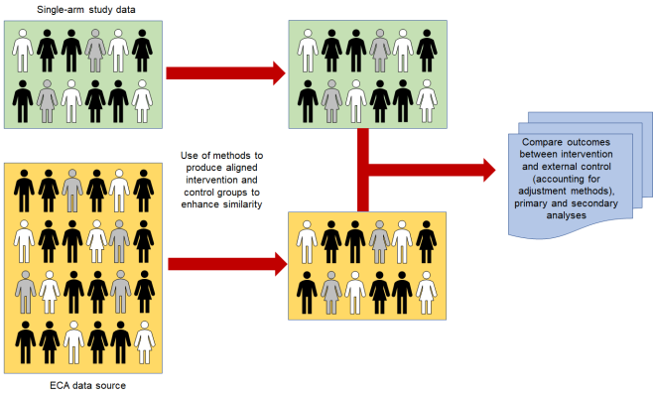
Background: Two Goals
For the placebo-controlled phase: use external controls to augment the control arm size and deliver better inference results
For the OLE phase: use external controls to provide aligned control groups for effect evaluation
Notes:
Remove the firefish

Slide 7
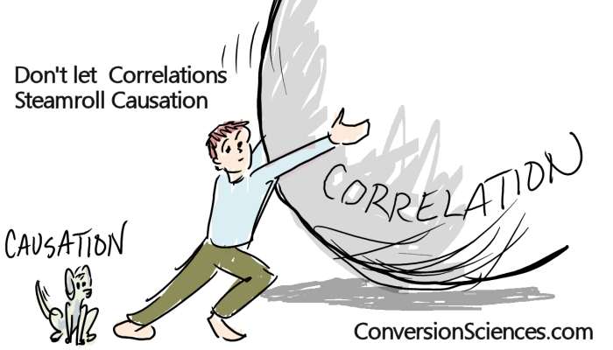
Methods: Causal inference for longitudinal outcomes
Placebo-controlled phase:
Weighting estimator combining internal and external data
Inverse probability weighting (IPW)
Augmented inverse probability weighting (AIPW)
Open-label extension phase:
Difference-in-differences (DID):
Inverse probability weighting (IPW)
Augmented inverse probability weighting (AIPW)
Outcome regression (OR)
Synthetic control method (SCM)
Notes:
Is it an abrupt jump in here? For audience who are not so familiar with Causal inference and the methods
Also do we want to list math formulas? Or just give some intuitions of the methods
A presentation from Xiner previously
Some unique things about the package

Slide 8
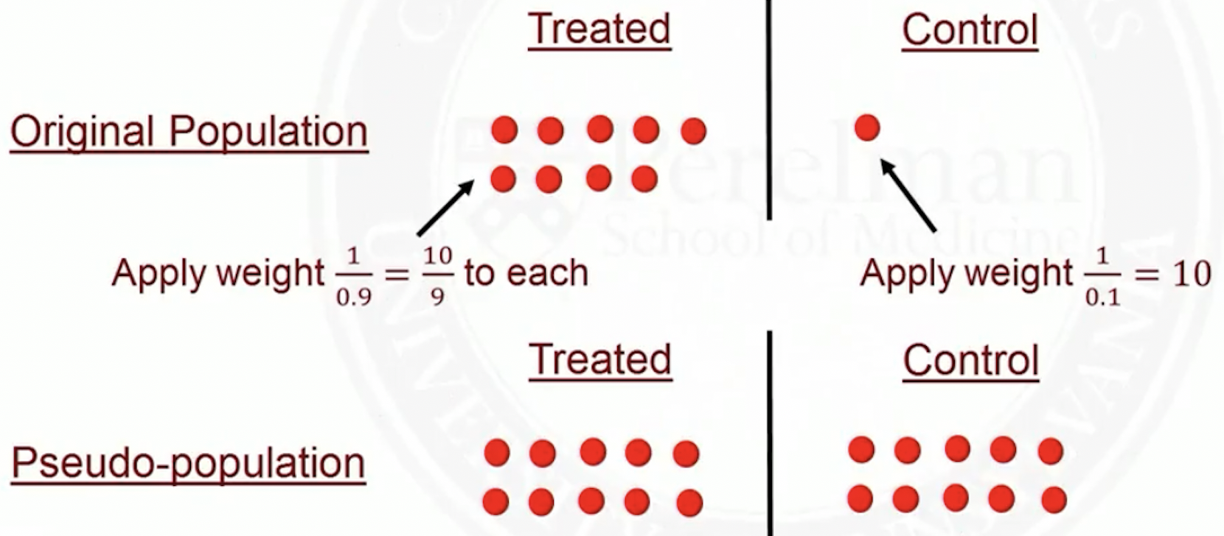
Methods: Placebo-controlled Phase
Analysis:
Inverse propensity weighting (IPW)
Augmented IPW
Simulation:
more for design purposes, reporting Type I error and power
Reference:
Zhou X, Zhu J, Drake C, Pang H (2024). “Causal Estimators for Incorporating External Controls in Randomized Trials with Longitudinal Outcomes.” In submission.
Notes:
Goal of the two parts: design and analysis Type I error and power

Slide 9
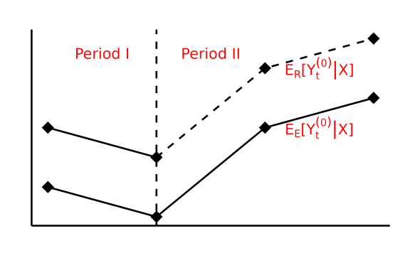
Methods: Open-label Extension Phase
Analysis:
Difference-in-differences (DID) and Synthetic control method
Simulation:
less for design, more for evaluation of methods
Reference:
Zhou X, Pang H, Drake C, Burger HU, Zhu J (2024). “Estimating treatment effect in randomized trial after control to treatment crossover using external controls.” Journal of Biopharmaceutical Statistics, pp. 1–29.
Notes:
Emph the questions we are answering

Slide 10
Package rdborrow: Highlights
rdborrow serves for two goals: placebo-controlled phase and OLE phase
Provides tools for effect estimation and trial designing in the placebo-controlled phase
Provides tools for long term effect evaluation in the OLE phase
rdborrow consists of two modules: Analysis and Simulation
Analysis: implements the EC borrowing methods for causal inference for longitudinal data
Simulation:
evaluating methods and process of external borrowing
provide guidance for the design of future randomized controlled trials
rdborrow integrates many technical features…
Object-oriented programming (OOP) with S4 class
Parallelization for bootstrap features
Notes:
Don’t put simulating future trial data - evaluating methods and process of external borrowing
More input here for what the columns mean
Emph that we do not need to have both parts for using the package - two parts are independent

Slide 11
Package rdborrow: Architecture
The package rdborrow consists of two modules: Analysis and Simulation
Analysis: analyzing existing trial data
implements the external control borrowing methods for estimating causal effects for longitudinal data, including placebo-controlled phase and OLE phase
Simulation: evaluating methods and process of external borrowing
use simulation to evaluate different data-generating processes and different borrowing methods
provide guidance for the design of future randomized controlled trials
Notes:
Don’t put simulating future trial data - evaluating methods and process of external borrowing
More input here for what the columns mean
Emph that we do not need to have both parts for using the package - two parts are independent

Slide 12
Package rdborrow: Architecture
We will showcase the structure with illustration based on a simulated data
A built-in dataset generated using the simulation feature of rdborrow, mimicking main study
Column info:
x₁ - x₄: baseline covariates
x₅: baseline outcome
A: treatment, 1 = treatment and 0 = control
S: trial status, 1 for RCT and 0 for External Control
y₁ - y₄: change of outcome from baseline

Slide 13
Package rdborrow: Analysis Module
analysis_obj
analysis_primary_obj
analysis_OLE_obj
method_obj
method_primary_obj
method_weighting_obj
method_DID_obj
bootstrap_obj
method_OLE_obj
method_SCM_obj

Slide 14
Package rdborrow: analysis class
analysis_obj: data, covariate_col_name, outcome_col_name, treatment_col_name, trial_status_col_name, method_obj, alpha
analysis_primary_obj: method_primary_obj
setup_primary_analysis()
run_analysis()
analysis_OLE_obj: method_OLE_obj, T_cross
setup_OLE_analysis()

Slide 15
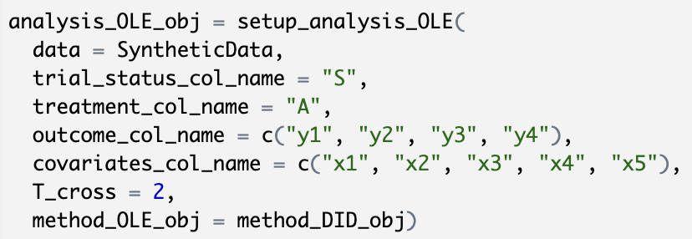
Package rdborrow: analysis class
For placebo-controlled phase…
Need a weighting method
For OLE phase…
Need a DID or SCM method
Notes:
Trial status

Slide 16
Package rdborrow: method class
method_weighting_obj: optimal_weight_flag,
wt,
model_form_piS,
model_form_piA,
model_form_mu0_ext,
model_form_mu0_rct,
model_form_mu1_rct
method_primary_obj
setup_method_weighting()
method_obj: method_name, bootstrap_flag, bootstrap_obj
method_DID_obj: method_name
bootstrap_flag,
bootstrap_obj,
model_form_piS,
model_form_piA,
model_form_mu0_ext,
model_form_mu0_rct
setup_method_DID()
method_OLE_obj
method_SCM_obj: lambda.min,
lambda.max,
nlambda,
parallel,
ncpus
setup_method_SCM()

Slide 17
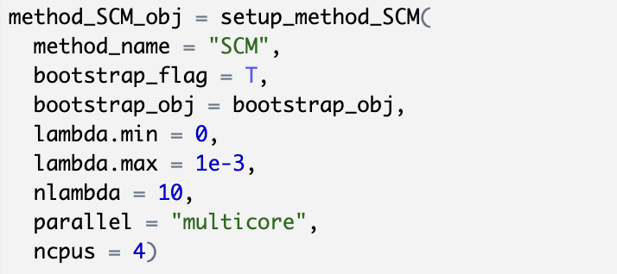
Package rdborrow: method class
Set up a weighting method…
Set up a DID method…
Set up a SCM method…

Slide 18
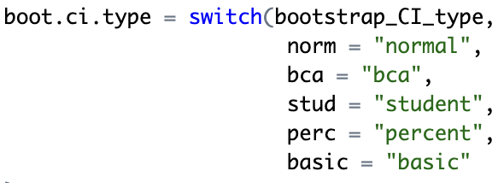
Package rdborrow: bootstrap class
- Set up a bootstrap object:
bootstrap_obj: replicates, bootstrap_CI_type
setup_bootstrap()
- Many boot options offered:

Slide 19
Package rdborrow: Simulation Module
Trial simulator
simulation_primary_obj
simulation_obj
simulation_OLE_obj
simulation_report
Notes:
Descriptions of the blocks
Flow: relationship between
Bootstrap into the method obj
Remove Analysis
Color shape

Slide 20
Package rdborrow: Simulation Module
simulate_X_dct_mvnorm()
simulate_X_mixture()
simulate_X_copula()
Trial simulator
simulate_trt_assign()
simulate_outcome_from_model()
simulate_trial()

Slide 21
Package rdborrow: Simulator
We consider a running setup to simulate covariates with:
n = 100 patients;
2 categorical covariates; one has two levels and the other has three levels;
2 continuous covariates.
Also generate outcomes from given models:
Multiple linear models
Model parameters from real SMA datasets (added noise for privacy concerns)

Slide 22
Package rdborrow: Simulator
Discretized multivariate normal way: - easy to implement - correlation is less interpretable
Mixture Gaussian way: - easy to interpret - may have too many levels with many categorical variables
Copula way: - very general marginal distributions - correlation for categorical variables is less interpretable

Slide 23
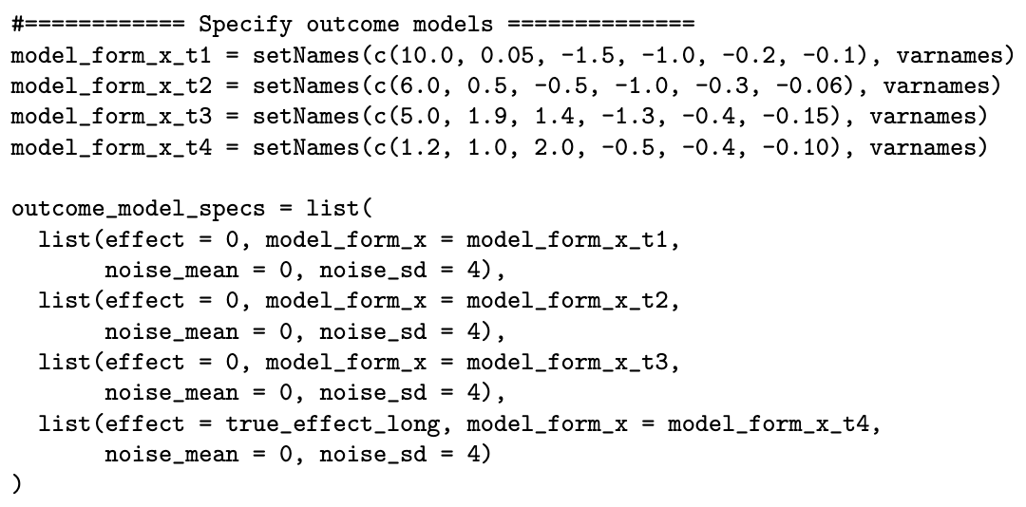
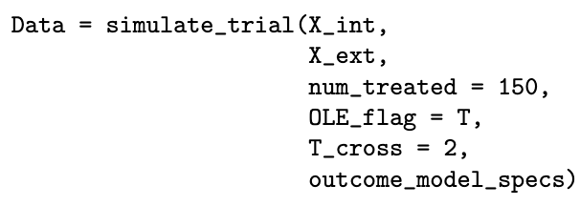
Package rdborrow: Simulator
Generate outcomes from prespecified models
Model parameters can mimic summary statistics from a target study
Generate trial data from covariates and outcomes

Slide 24
Package rdborrow: Simulation Module
simulation_obj: trial_status_col_name, treatment_col_name, outcome_col_name,
covariate_col_name,
method_obj_list, alpha, method_description
simulation_primary_obj:
method_primary_obj_list, data_matrix_list_null,
data_matrix_list_alt, true_effect,
alt_effect
run_simulation()
simulation_OLE_obj: T_cross,
method_OLE_obj_list, data_matrix_list,
true_effect
Notes:
Descriptions of the blocks
Flow: relationship between
Bootstrap into the method obj
Remove Analysis
Color shape

Slide 25
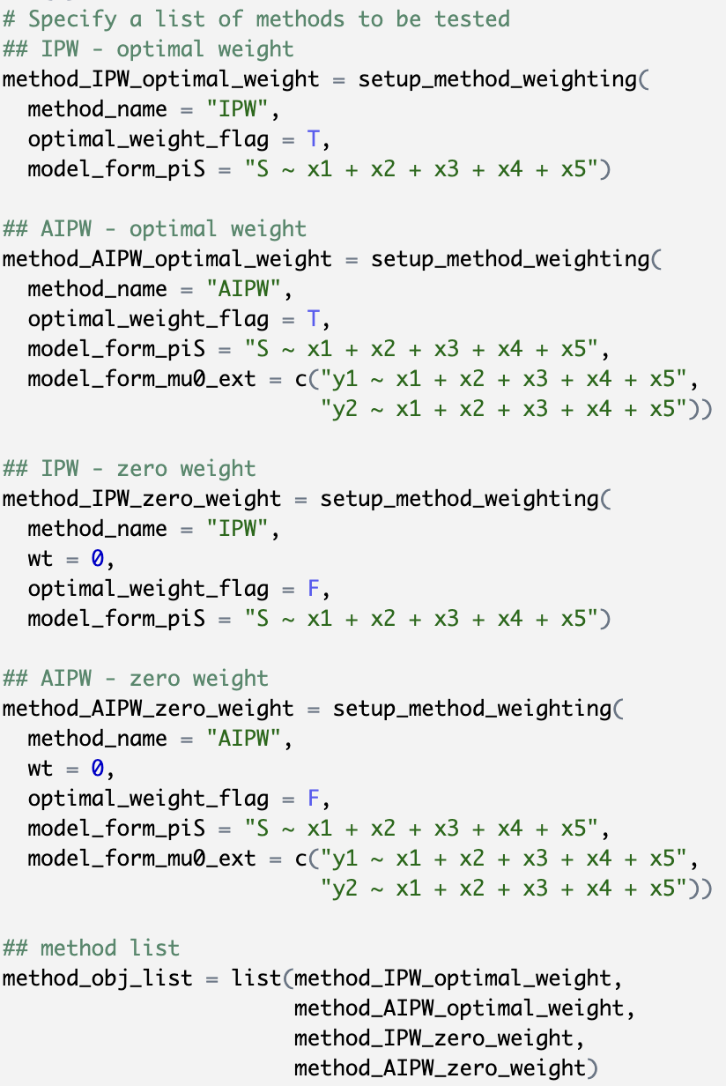
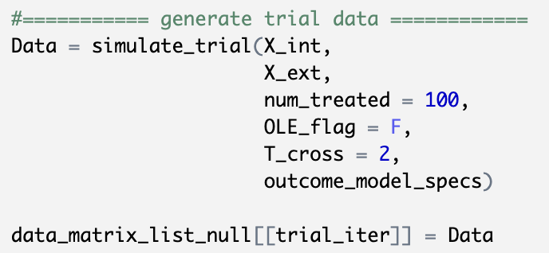
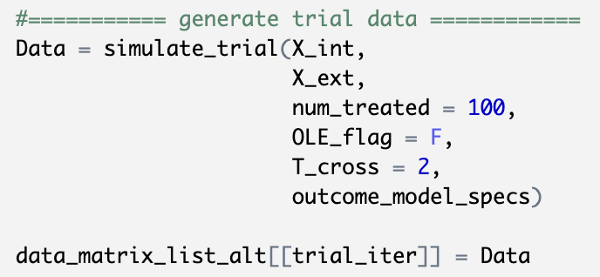
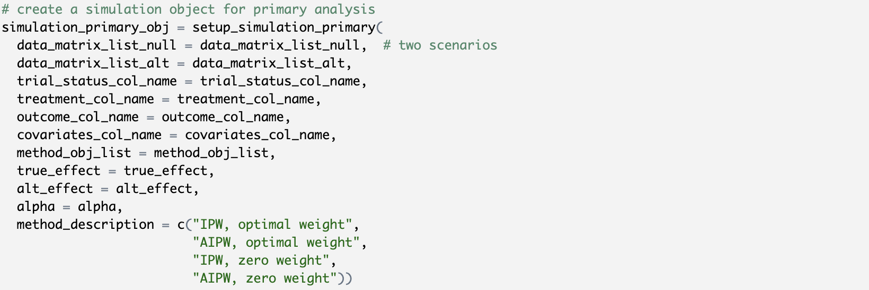
Package rdborrow: Simulation class
Method list
Data list

Slide 26
Package rdborrow: Simulation Module
simulation_report_obj:
bias, mse,
variance, coverage,
type_I_error,
power
show()
Notes:
Descriptions of the blocks
Flow: relationship between
Bootstrap into the method obj
Remove Analysis
Color shape

Slide 27
Package rdborrow: numerical experiments
We conducted a set of numerical experiments to test the features & instruct the usage of the package
A sketch for Analysis:
Simulated a dataset based on the real trial data
Used the first two follow-up visits for primary analysis
Used the all four follow-up visits for OLE phase analysis
A sketch for Simulation:
Hypothesis testing in the placebo-controlled phase
Hypothesis testing in the OLE phase
We will mainly showcase the results for placebo-controlled phase

Slide 28
Package rdborrow: numerical experiments
Analysis in placebo-controlled phase
AIPW with only RCT
AIPW with optimal weight
AIPW with bootstrap
Summary:
Both achieved good coverage for the ground truth for the placebo-controlled phase
By incorporating the external controls with a data-adaptive weight, the confidence band is further shortened

Slide 29
Package rdborrow: numerical experiments
Simulation in placebo-controlled phase
Testing the hypothesis:
Results:

Slide 30
Demo coding with rdborrow
Chen will showcase some live demo results for rdborrow!
Analysis Module
Simulating a trial data
Primary analysis
OLE phase analysis
Simulation Module
Primary analysis
OLE phase analysis

Slide 31
Discussion
Incorporating nonparametric methods or machine learning into the external control borrowing workflow
Incorporating methods and features to handle missing data in the package
Developing a more user-friendly interface with Shiny or other web-based applications

Slide 32
Acknowledgement
This work is partially supported by a grant from the FDA (HHS U01 FD007206, Pang and Zhu).
We also thank Matt Secrest for sharing information about the psborrow2 package and helping with the development of rdborrow.

